Slide 1
Radio Software
Huawei Active Antennas
Design Guideline
September 2014
C2

Slide 2
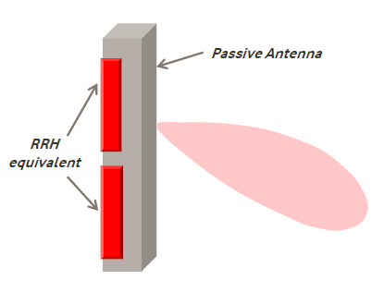
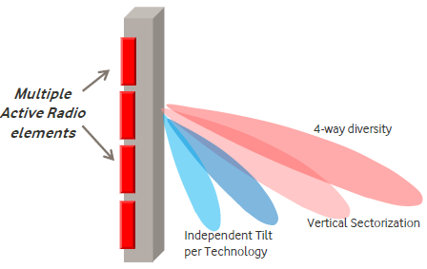
Types of AA - Definition
VELCRO
SMART
RU attached to the back side of the antenna
Array of active elements interconnected to the antenna
C2

Slide 3
Types of AA – Available Models for Rollout
VELCRO
SMART
RU attached to the back side of the antenna
Integrated RU with beamforming capabilities
AAU3911
High Bands active
High Bands active
C2

Slide 4
AAU3902 – Smart AA Solution
AAU3902 is a 2.0 m triple-array antenna solution capable to provide active TX beamforming
Active beamforming is available for higher bands, AAU3902 can handle up to 2 active bands/RAT at a time
Up to 5 bands can be radiated using a single AAU3902 antenna (external combiners may be needed, depending on bands combination)
AAU3902 is suitable for site configurations with 1 antenna per sector.
In case of 2 antennas/sector, AAU3902 shall be dedicated to ‘active’ higher bands features leaving ‘passive’ bands to ‘legacy’ antenna
AAU3902 provides a couple of remarkable beamforming features (available for 3G and 4G)
Vertical 4way RX (UL only): increases UL traffic and reduces the UL load
Vertical Multiple Sectors (UL & DL): increases UL/DL cell capacity
Such features can be switched on alternatively and cannot coexist
Other features are available, as well
AAU3902 is available from SRAN8.0 onwards
C2

Slide 5
AAU3911 – Velcro AA Solution
AAU3911 is the Velcro solution from Huawei portfolio
RRU integrated in the antenna
No TX active beamforming available
AAU3911 is a 2.0 m triple-array antenna capable to provide 4 way UL diversity (2T4R)
A low-band passive array handles 800 and 900MHz bands (with ext. combiners)
A couple of high band arrays handle up to 2 active bands (1.8A, 2.1A or 2.6A)
Also ready for 1.8P+2.1P (2T2R) (needs integrated combiner)
Antenna-integrated RRUs can provide up to 2x60W RF power
AAU3911 ensures horizontal 4 way UL diversity using a couple of high-band arrays
Horizontal 4way diversity: the 2 Xpol arrays have the same coverage footprint
AAU3911 is available from 4Q2014
C2

Slide 6
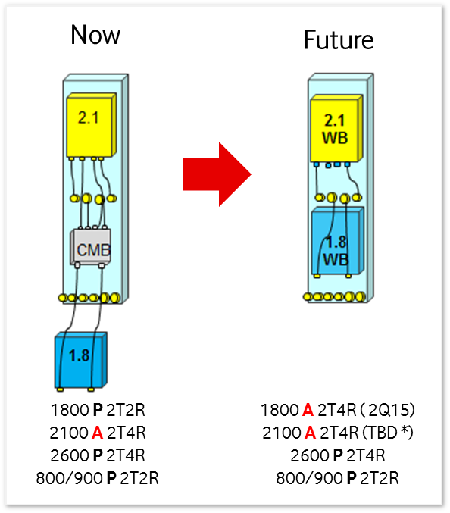
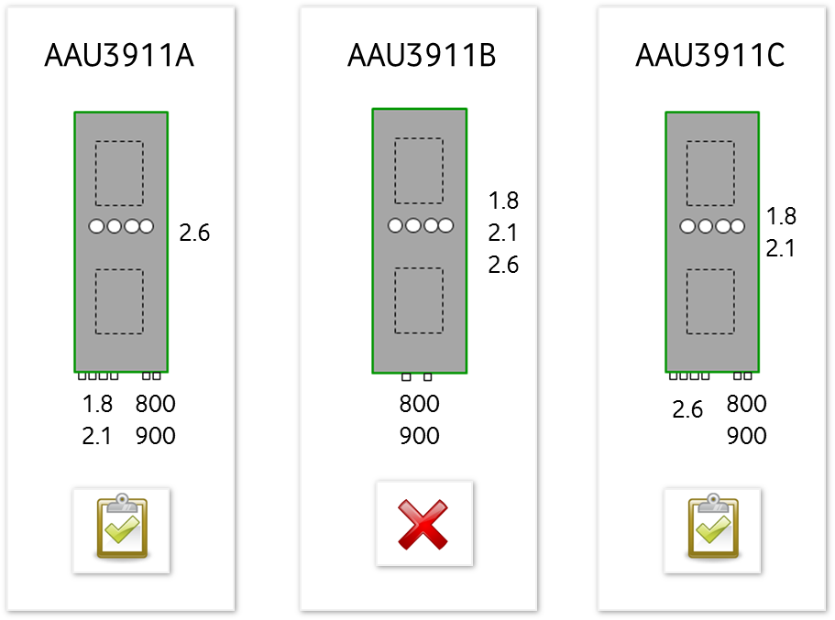
AAU3911 – Velcro AA Solution
AAU3911C 2.1A
C2

Slide 7
Passive vs. Active Antenna – General Specifications
 | Passive | Velcro | Smart
PIM | Low quality installation | NO | NO
Cable losses (w/ RRU) | 0,48dB – 5,97dB (typ. 1,5dB) | NO | NO
4-way diversity | With 4 ports (only 2.6GHz) | YES (high bands) | YES (high bands)
RET | Ready old models Integrated new models | Integrated | Integrated
Roadmap | Very extensive | Limited | Limited
Poles for full bands | 1 | 1 or 2 | 1 or 2
Passive Sharing | YES | Limited | Limited
Power | 2x40W or 2x60W | 2x40W or 2x60W | 2x40W
Modular RU | YES | YES | YES
MDT | YES | tbd | 3º
C2

Slide 8
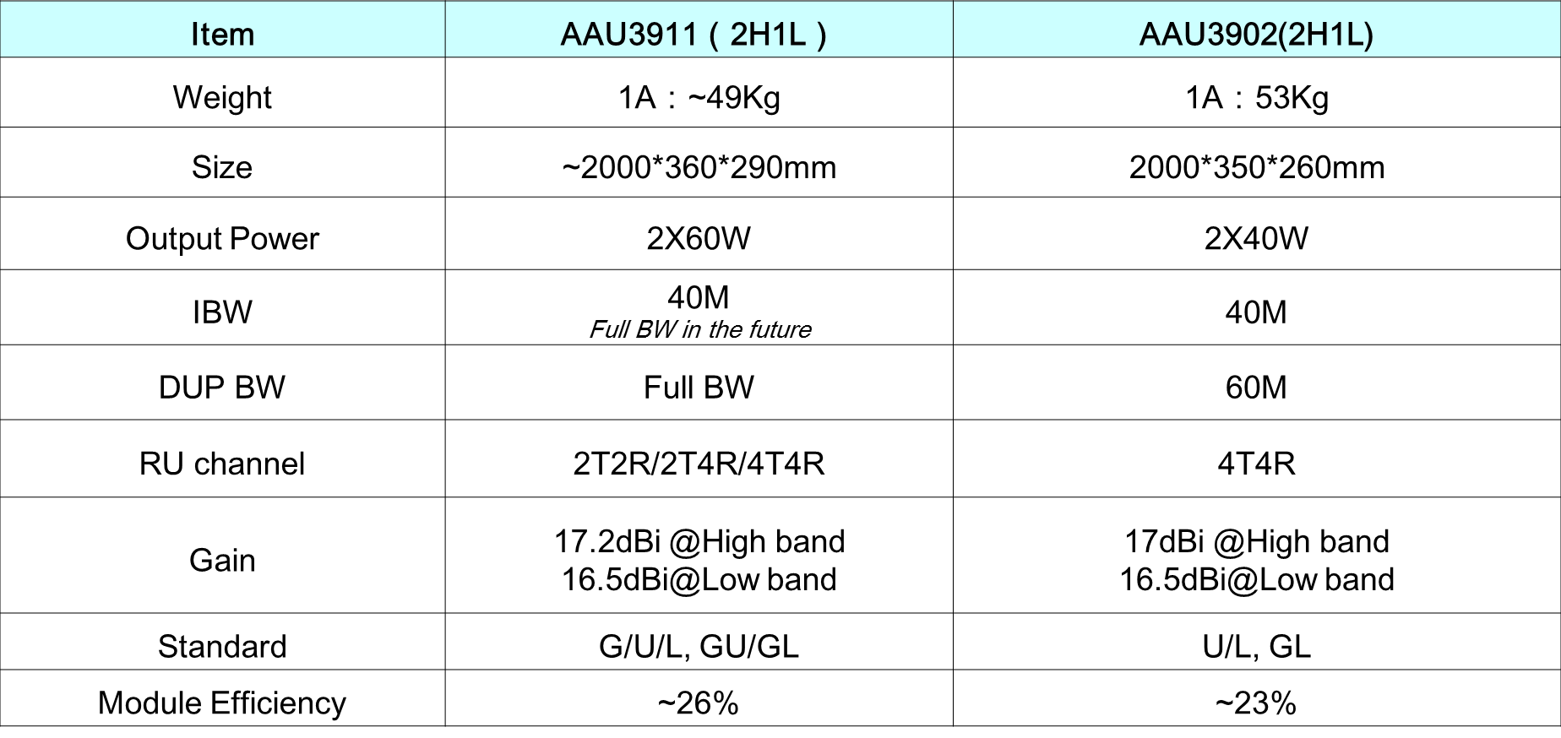
Active Antenna – Specifications
C2

Slide 9
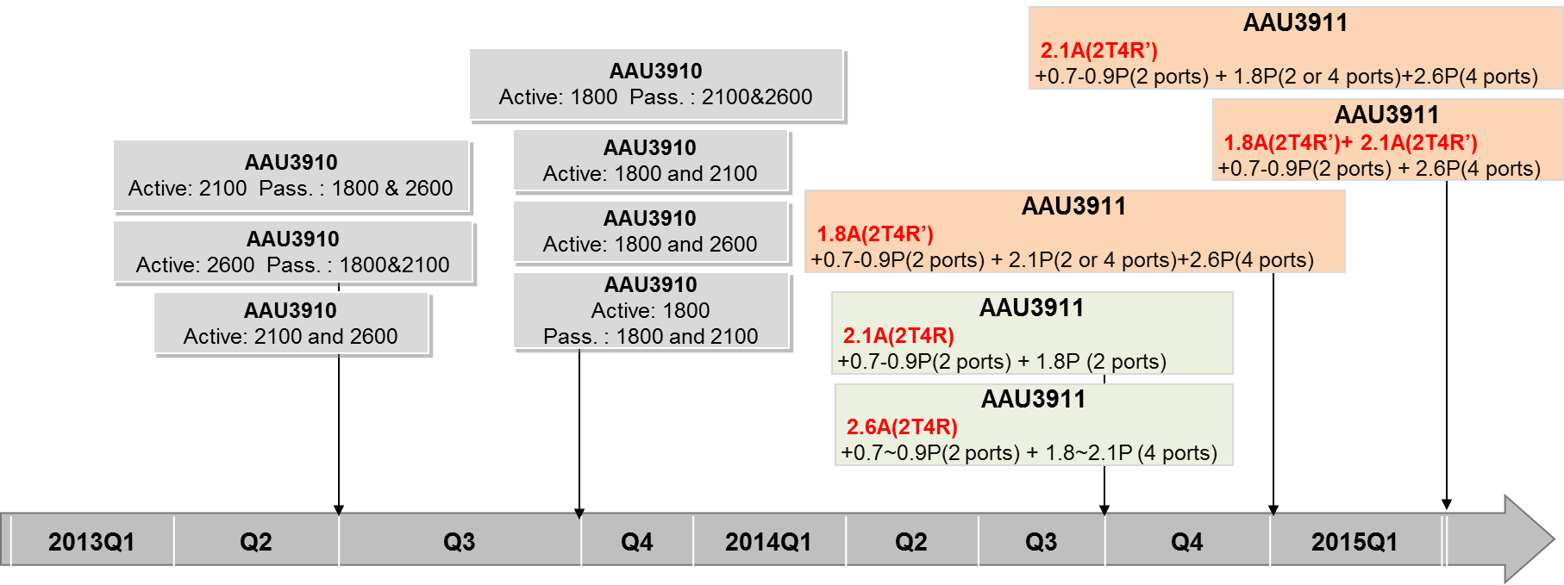
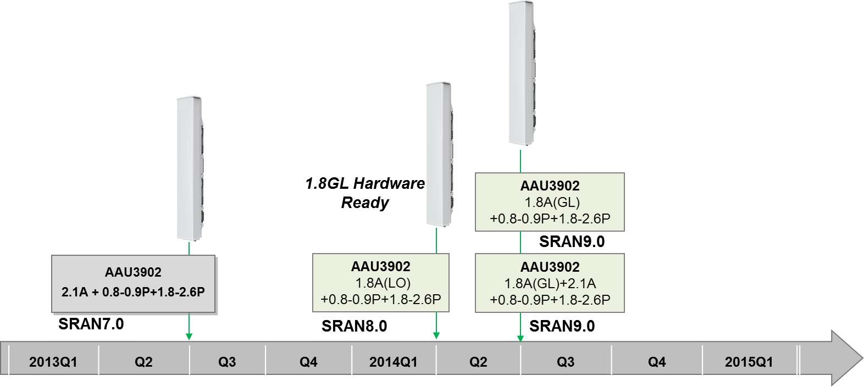
Active Antenna – Roadmap
C2

Slide 10
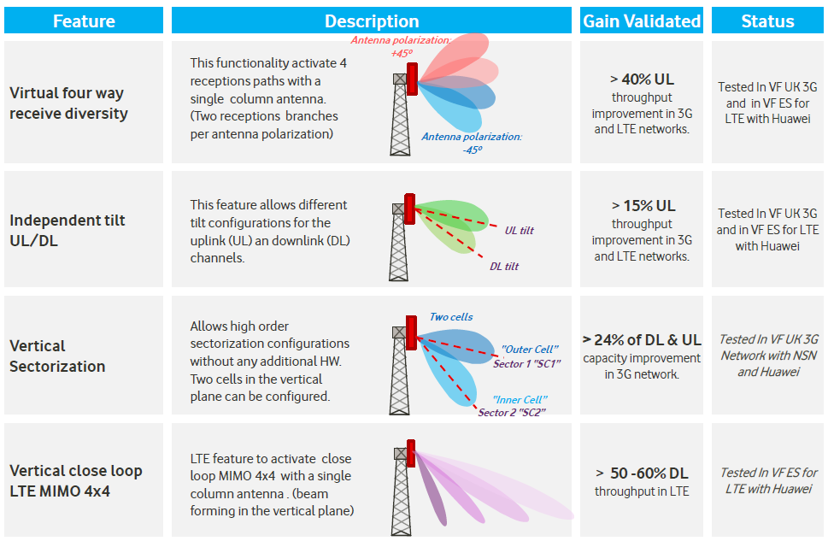
Smart Antenna Features
Feature activation per carrier
C2

Slide 11
AAU3902 – Beamforming Features Compatibility
 | V4R | vertical sectorization | independent tilt per carrier | independent tilt UL/DL | V4T
V4R | - | NO | YES Beam 1 - Beam 2 = VHPBW | YES Beam 1 - Beam 2 = VHPBW | YES Beam 1 - Beam 2 = VHPBW Same tilt for V4T and V4R
independent tilt UL/DL | - | YES Beam 1 - Beam 2 < VHPBW | - | - | YES Beam 1 - Beam 2 = VHPBW
independent tilt per carrier | - | YES Tilt beam1 - beam2 of F1 = VHPBW Tilt Beam1 - Beam2 of F2 < VHPBW | - | - | YES Tilt beam1 - beam2 of F1 = VHPBW Tilt Beam1 - Beam2 of F2 < VHPBW
C2

Slide 12
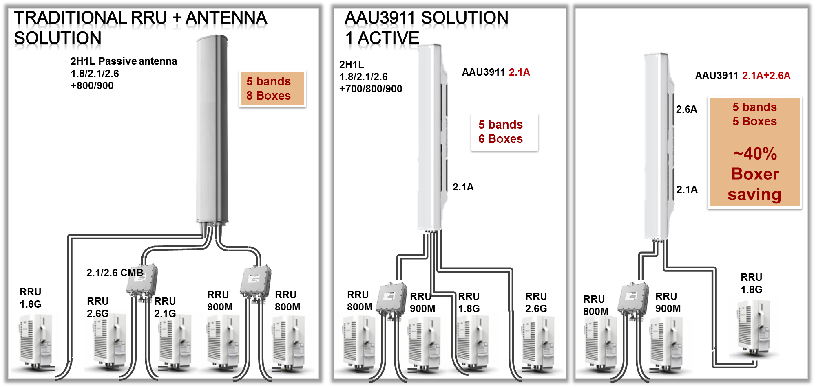
Site Evolution with AAU (example)
C2

Slide 13
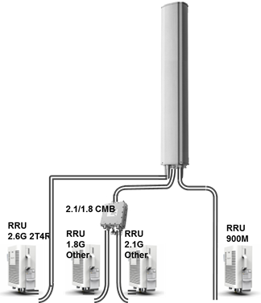
Site Evolution: Target configuration with AAU (example)
C2

Slide 14
Application Scenarios: General Rules
AA is the first option to take into account if it is needed to act over a site, and antenna replacement is necessary or new RRU outdoor placement it is not feasible. Main scenarios are: New site, LTE upgrade, RAN Refresh or 3G capacity upgrade.
When a new AA is deployed we must assure future proof, in order to allow most probable bands deployment (800, 900, 1800, 2100 and 2600MHz).
Regarding passive site sharing, when a new AA is deployed we must assure that current or potential future sharing in the site is feasible without AA remove, at least for one additional operator.
Where RRU indoor equipment is removed, AA provide remarkable energy savings.
C2

Slide 15
AAU3902 – Advantages and Drawbacks
Main advantages:
Triple-array broad band antenna, handling 5 bands (with ext. combiner)
Up to 2 active bands on separate arrays (1.8A+2.1A)
Independent tilt per band
Low RF losses, similar EIRP of 2x60W RRU
Different ‘active‘ features available depending on scenario/traffic needs
Capable to handle high capacity traffic in a number of network scenarios
Energy savings (reduced power consumption)
Performance improvement seen on field
Drawbacks:
Heavy weight (>50 Kg) may be a limiting factor for installations
Not suitable for replacement of 1.3 m or slim passive antennas
Increased hardware complexity
Some beamforming features cannot coexist
GL1800 configurations requires SingleOM and GBBP/UBBP boards
C2

Slide 16
AAU3911 – Advantages and Drawbacks
Main advantages:
Triple-array broad band antenna, handling 5 bands (with ext. combiner)
Up to 2 active bands for 2T4R
Low RF losses, same or better EIRP of 2x60W RRU
Energy savings (reduced power consumption), mainly for indoor RRU
Drawbacks:
Heavy weight (near 50 Kg) may be a limiting factor for installations
Not suitable for replacement of 1.3 m or slim passive antennas
To handle 5 bands in a single antenna could limit 2R4T capabilities
Limited independent tilt per band
C2

Slide 17
AAU39xx – Use Case: 3G Capacity
Sites with 4 carriers deployed, and capacity upgrade necessary
AAU3902 2.1A (V4R or VMS)
Constraints for AA use:
Site shared or potentially shared: One antenna for only VDF use (as an exception, feasible to use AAU3902 passive ports to share)
No slim site
With LTE2600, necessary 2 antenna to maintain 2T4R
Infra requirements
65º horizontal beamwidth
2x40W AAU3902 2.1A, potential slight coverage decrease (depending baseline RRU placement)
17

Slide 18
AAU39xx – Use Case: 3G Capacity
FY2014-15
Q3
FY2014-15
Q4
FY2015-16
(Single OM)
3G site 4 carriers/sector and new carrier needed
Fulfill AAU3902 constraints?
(*) RRU2100 reuse in other site
N
Horizontal
Sectorisation
Y
LTE1800
Cosite?
N
(**) SRAN9.0 for 2 Active bands
AAU3902 2.1A
V4R or VMS (*)
Y
DCS
Cosite?
AAU3902 2.1A
V4R or VMS
(*) (**)
AAU3902 1.8A+2.1A
V4R or VMS (*) (****)
(***) Single OM for GL mode
N
Y
AAU3902 1.8A+2.1A
V4R or VMS (*) (****)
(****) RRU1800 reuse in other site
AAU3902 2.1A
V4R or VMS (*) (***)
18

Slide 19
AAU39xx – Use Case: New Site
New site deployed
AAU3911 2.1A (H4R), and 1.8A (H4R) if LTE1800 needed since 1Q2015.
AAU3902 2.1A and 1.8A for hot spot sites
Constraints for AA use:
Site shared or potentially shared: One antenna for only VDF use (as an exception, feasible to use AAU3902 passive ports to share)
No slim site
Infra requirements
65º horizontal beamwidth
2 active bands since 1Q2015 and SRAN9.0
19

Slide 20
AAU39xx – Use Case: New Site
FY2014-15
Q3
FY2014-15
Q4
FY2015-16
(Single OM)
New site
Fulfill AAU39xx constraints?
N
Passive
Solution
Y
N
Hot Spot
>3 3G carriers?
N
U2100 or LTE1800 needed?
AAU3902 2.1A
V4R or VMS
AAU3911 2.1A
H4R
Y
Y
LTE1800
needed?
N
AAU3902 1.8A
V4R or VMS
AAU3911 1.8A+2.1A
H4R
Y
DCS
needed?
N
AAU3902 2.1A
V4R or VMS (***)
AAU3911 1.8A+2.1A
H4R
(**) SRAN9.0 for 2 Active bands
Y
LTE1800
needed?
N
AAU3902 2.1A
V4R or VMS
(***) Single OM for GL mode
Y
DCS
needed?
AAU3902 1.8A
V4R or VMS (**)
AAU3902 1.8A+2.1A
V4R or VMS
N
20
AAU3902 2.1A
V4R or VMS (***)
AAU3902 1.8A+2.1A
V4R or VMS
Y

Slide 21
AAU39xx – Use Case: LTE Upgrade/RAN Refresh
LTE Upgrade with antenna change or new RRU without installation place
4 carrier sites: AAU3902 1.8A (V4R or VMS) (2.1A if G1800 cosite)
<4 carrier sites: AAU3911 2.1A (H4R) (1.8A since 2Q2015)
Constraints for AA use:
Site shared or potentially shared: One antenna for only VDF use. As an exception, feasible to use AAU3902 passive ports to share
No slim site
With LTE2600, necessary 2 antenna to maintain 2T4R
Infra requirements
65º horizontal beamwidth
2x40W AAU3902 2.1A, potential slight coverage decrease
2 active bands Huawei AAU since 1Q2015 and SRAN9.0
21

Slide 22
AAU39xx – Use Case: LTE1800 Upgrade
FY2014-15
Q3
FY2014-15
Q4
FY2015-16
(Single OM)
LTE1800 upgrade with antenna change or new RRU without outdoor place
Fulfill AAU39xx constraints?
N
Passive
Solution
Y
(*) RRU2100 reuse in other site
Hot Spot
>3 3G carriers?
DCS
Cosite?
N
N
N
AAU3902 1.8A
V4R or VMS
AAU3911 1.8A
H4R
Y
Y
Passive
Solution (***)
AAU3911 1.8A
H4R
(**) SRAN9.0 for 2 Active bands
DCS
Cosite?
(***) Single OM for GL mode
N
AAU3902 1.8A
V4R or VMS (**)
AAU3902 1.8A+2.1A
V4R or VMS (*)
Y
AAU3902 1.8A+2.1A
V4R or VMS (*)
AAU3902 2.1A
V4R or VMS (*) (***)
22

Slide 23
AAU39xx – Use Case: LTE800 Upgrade
FY2014-15
Q3
FY2014-15
Q4
FY2015-16
LTE800 upgrade with antenna change or new RRU without outdoor place
Fulfill AAU39xx constraints?
N
Passive
Solution
Y
N
Hot Spot
>3 3G carriers?
U2100 or LTE1800 Cosite?
N
N
(*) RRU2100 reuse in other site
Y
N
AAU3902 2.1A
V4R or VMS (*)
AAU3911 2.1A
H4R (*)
Y
Y
RRU place
LTE1800
Cosite?
(**) SRAN9.0 for 2 Active bands
N
Passive
Solution
AAU3911 1.8A
H4R (****)
Y
(***) Single OM for GL mode
DCS
Cosite?
N
Passive
Solution (***)
AAU3911 1.8A
H4R (****)
(****) RRU1800 reuse in other site
Y
DCS
Cosite?
N
AAU3902 1.8A
V4R or VMS
(**) (****)
AAU3902 1.8A+2.1A
V4R or VMS (*) (****)
Y
AAU3902 1.8A+2.1A
V4R or VMS (*) (****)
AAU3902 2.1A
V4R or VMS (*) (***)
23

Slide 24
AAU39xx – Use Case: RAN Refresh/3G Only Upgrade
FY2014-15
Q3
FY2014-15
Q4
FY2015-16
RR o 3G upgrade with antenna change or new RRU without outdoor place
Fulfill AAU39xx constraints?
N
Passive
Solution
Y
N
Hot Spot
3 U2100 carriers?
U2100 or LTE1800 Cosite?
N
N
(*) RRU2100 reuse in other site
Y
N
AAU3902 2.1A
V4R or VMS (*)
AAU3911 2.1A
H4R (*)
Y
Y
RRU place
LTE1800
Cosite?
(**) SRAN9.0 for 2 Active bands
N
Passive
Solution
AAU3911 1.8A
H4R (****)
Y
(***) Single OM for GL mode
DCS
Cosite?
N
Passive
Solution (***)
AAU3911 1.8A
H4R (****)
(****) RRU1800 reuse in other site
Y
DCS
Cosite?
N
AAU3902 1.8A
V4R or VMS
(**) (****)
AAU3902 1.8A+2.1A
V4R or VMS (*) (****)
Y
AAU3902 1.8A+2.1A
V4R or VMS (*) (****)
24
AAU3902 2.1A
V4R or VMS (*) (***)

Slide 25
Backup

Slide 26
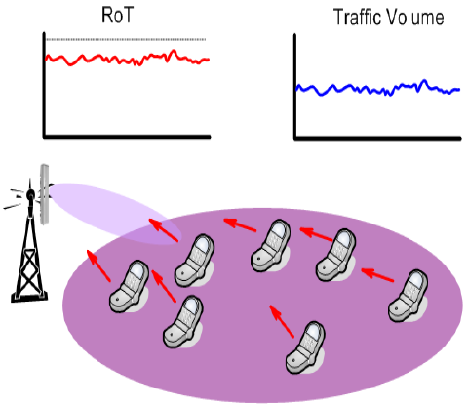
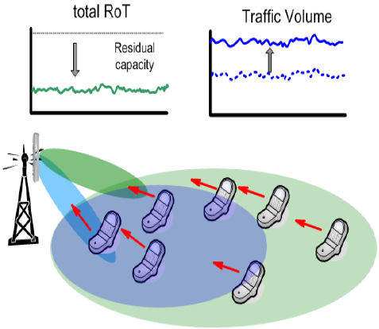
AAU3902 – Vertical 4 UL Channels 1/2
It implements 4-way antenna receive diversity. It just affects UL traffic.
4 way RX diversity provides better signal quality on the uplink so the advantage of such feature is dual:
It helps to keep the UL load under control (same UL throughput achieved with lesser UL load)
It increases the UL throughput in poor coverage areas.
Results confirmed by trial
V4RX

Slide 27
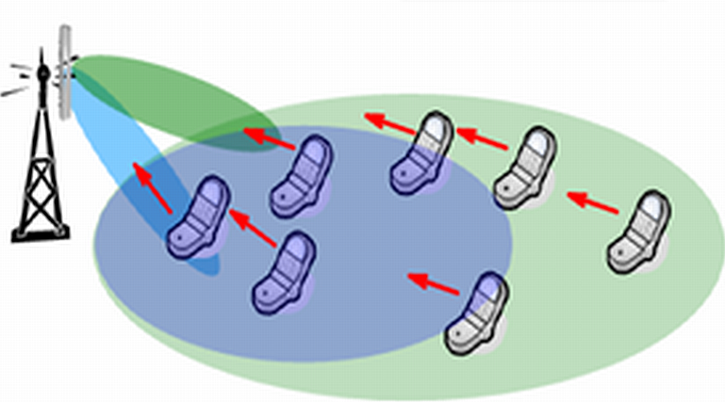
AAU3902 – Vertical 4 UL Channels 2/2
V4R is achieved through the overlapping of a second X polarised beam (dubbed ‘inner beam’ – used for UL only) whose footprint is different (and smaller) than the original beam (‘outer beam’) providing primary DL/UL coverage.
Dual UL coverage is truly effective in the portion of the original cell where inner and outer beams are superimposed.
UL load is reduced on the whole original cell, therefore any user of the original cell takes advantage of the additional receivers even if the 2 beams are not totally overlapped.
Outer beam (UL+DL)
Inner beam (UL)
Dual UL Coverage

Slide 28
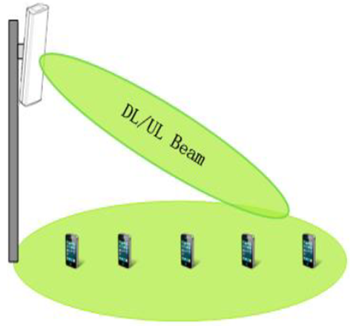
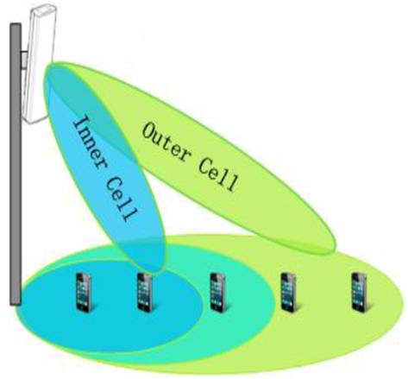
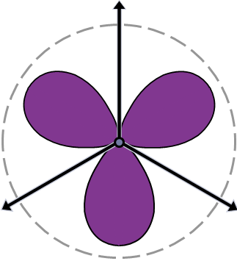
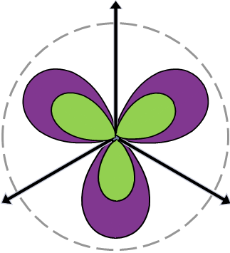
AAU3902 – Vertical Multiple Sectors
It splits a sector into an inner cell and an outer cell. It affects both UL/DL traffic.
Overall RRU power is divided for inner and outer cells (also not symmetrically)
Cell overlap depends on beams tilt:
Cell splitting increases the single user throughput as more resources are available,
Overall interference (particularly at cell edges) may be reduced,
An excessive cells overlap may raise the interference in the inner cells.
Such a feature, to be truly effective, may require a general re-alignment of the antenna parameters (antennas downtilt angles) of surrounding sites.
It may be an issue if RET for passive antenna is not available for installed antennas
VMS

Slide 29
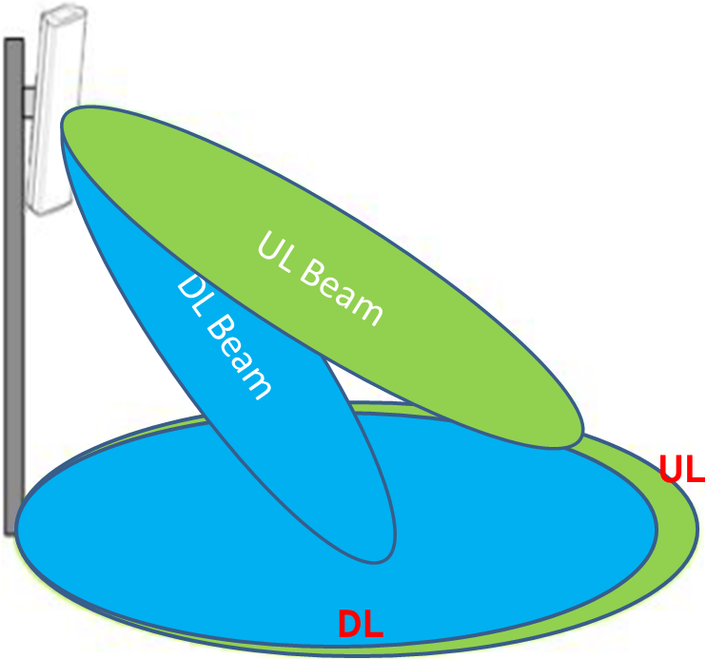
AAU3902 – Indipendent Tilt for UL and DL
In ‘traditional’ coverage with RxUs and legacy antennas UL and DL downtilt angles are the same
In cells served by AAU3902, the Independent Tilt for Uplink and Downlink feature enables different downtilt angles for uplink and downlink beams
It is possible to balance uplink and downlink coverage.
The benefit of Independent tilt UL/DL strongly depends on the network scenario, it may be considered as an additional optimization tool for cells fine tuning.
VMS

Slide 30
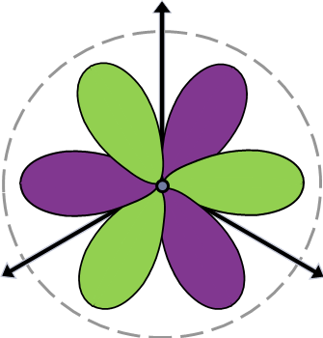
Horizontal vs Vertical Sectorization
Horizontal Sectorization (Conventional)
Achieved swapping existing 65° passive antennas with dual beam ones
Each beam is narrower and covers a portion of the original cell
The footprint of the resulting cells is typically bigger than the original one
Application is limited by narrow-beam antennas availability
New RF modules are added
Overall power increased (may be doubled)
Interference issues
Vertical Sectorization (AAU3902)
Feature Activation triggered by traffic needs
Inner and outbeam can be optimized (Tilt, Power)
Feature can be switched off if needed (and other features activated)
Interference mitigation is easier than with conventional horizontal sectorization with passive antennas
Overall AAU RF power is split among inner/outer cells
The overall power (EiRP) is not increased.
Reduced interference (and it can be mitigated by changing inner/outer downtilts)

Slide 31
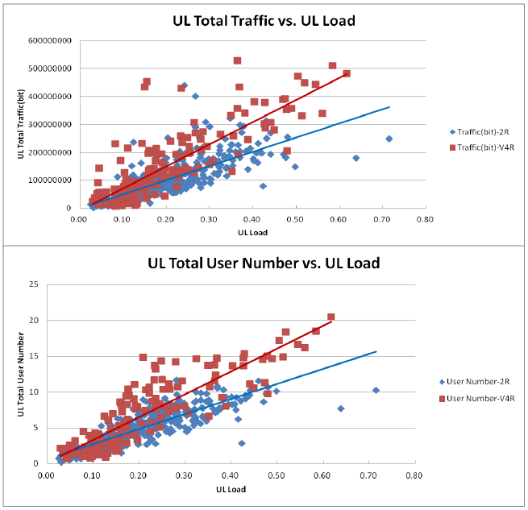
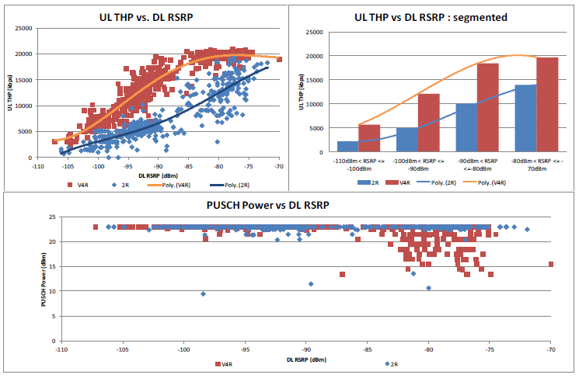
Smart Features – Main Results V4R
UMTS
LTE

Slide 32
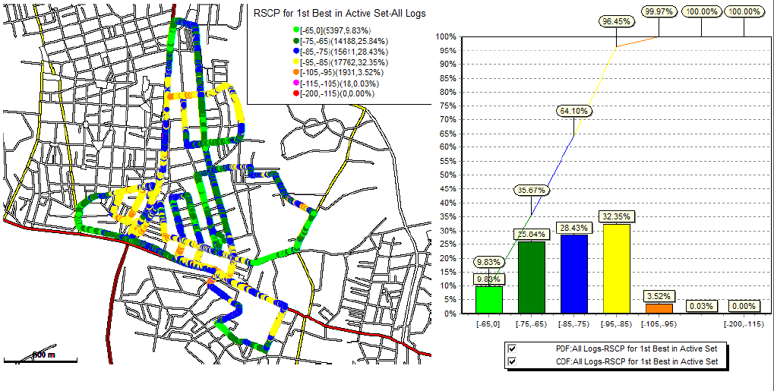
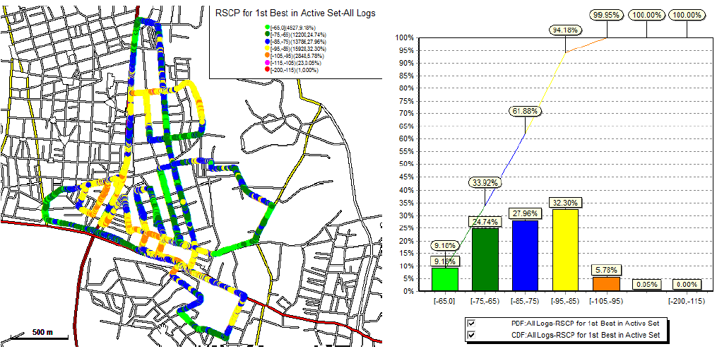
Smart Features – Main Results VMS
UMTS Coverage
Passive
UMTS Coverage
Active VMS
C2

Slide 33
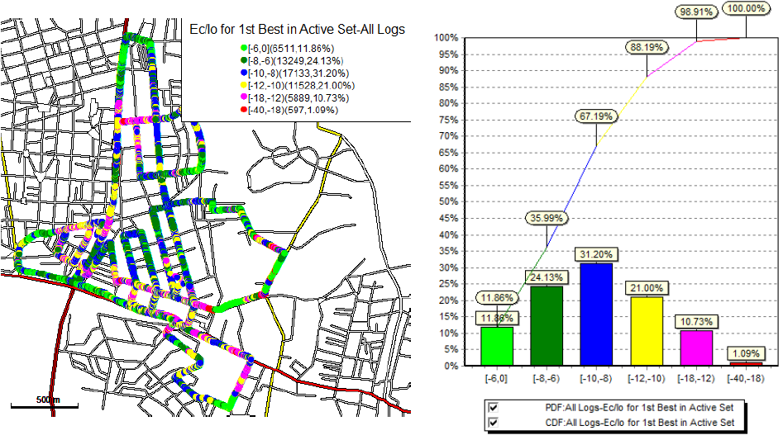
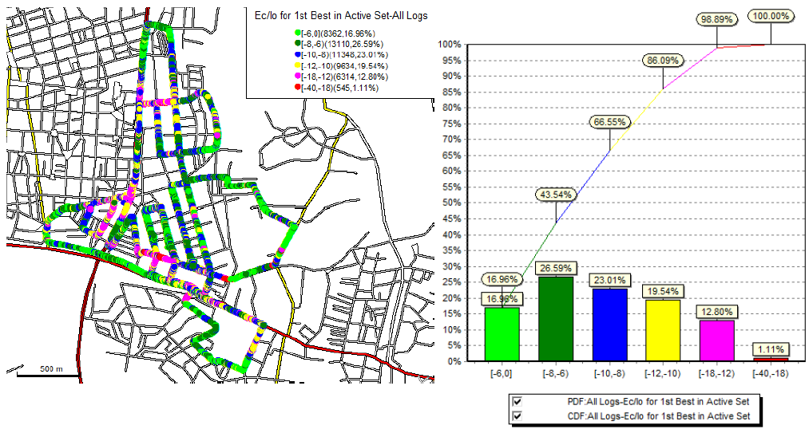
Smart Features – Main Results VMS
UMTS EcIo
Passive
UMTS EcIo
Active VMS
C2

Slide 34
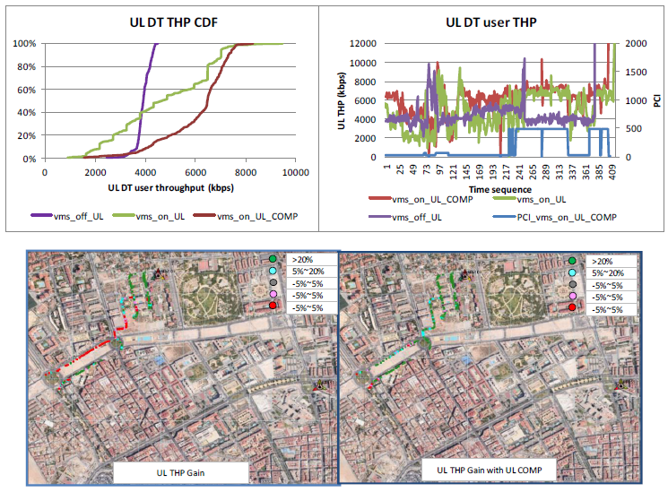
Smart Features – Main Results VMS
LTE UL
C2

Slide 35
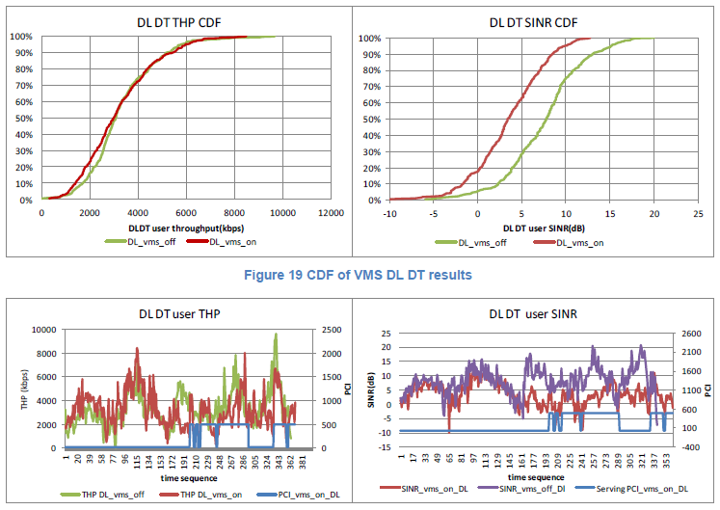
Smart Features – Main Results VMS
LTE DL
C2

